Slide 1

C Installation on Linux

Slide 2
Command to install C:
gcc –-version
Sudo apt install gcc

Slide 3
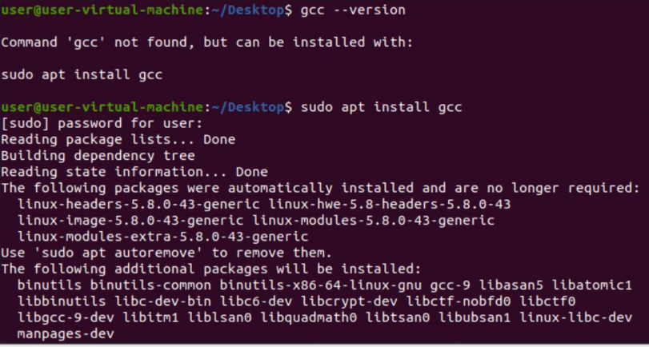
Output:

Slide 4
Command to Compile:
gcc filename.c
Command to Run:
./a.out

Slide 5
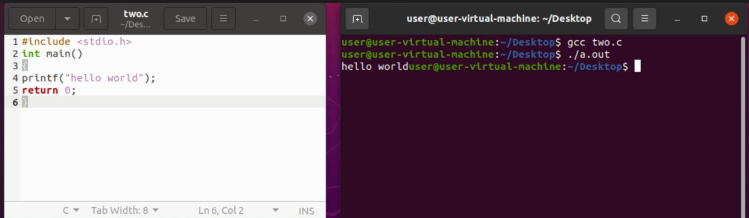
Output

Slide 6
Thank You

